Slide 1
Mefloquine Use in the
Canadian Armed Forces
29 June 2017

Slide 2
Background
Malaria is a health and potential operational threat in some deployment areas (e.g., Africa)
CAF follows the Public Health Agency of Canada (PHAC) advice on malaria prevention
3 malaria prevention medicines are suitable for chloroquine-resistant areas: mefloquine, doxycycline and atovaquone-proguanil (AP)
Concerns have been raised about the safety of mefloquine
Standing Committee on Veterans Affairs, media, individual citizens (e.g., veterans) and some scientific proponents
Based on CDS direction, SG committed to developing and delivering a report on mefloquine use by the CAF

Slide 3
Approach
Emphasis on scientific evidence for military populations
PHAC and Health Canada already have reviewed the overall evidence for Canadians
Report developed with in-house expertise
Timelines and historical knowledge precluded other options
Beneficial for understanding confounders, ready access to CATMAT, knowledgeable of history of mefloquine use in the CAF
Is a potential criticism (conflict of interest)
Major areas of inquiry
CAF experience with mefloquine (including Somalia)
Assessment of compliance with prescribing requirements
Comparison of CAF to international, national and military guidelines
Systematic review and analyses of military-specific safety information (vs. alternative medications)

Slide 4
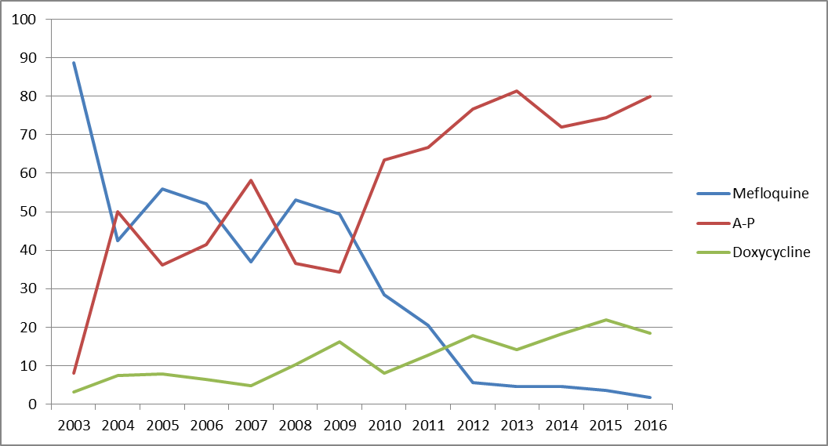
Key findings (1) CAF experience with mefloquine
Mefloquine has been used for several decades; approximately 18,000 CAF members have been prescribed this drug
Use of mefloquine has dropped substantially over time
20 prescriptions in 2016
%

Slide 5
Key findings (2) Is the CAF following recommended practices for prescribing mefloquine?
The CAF malaria policy is generally being followed, i.e. personnel receiving prescriptions have a face to face encounter with a clinician, however:
there is insufficient documentation of screening for contraindications
some personnel have received a prescription for mefloquine despite evidence of potential contraindications or precautions in their medical records (we are investigating these as patient safety incidents)

Slide 6
Key findings (3) Is the CAF approach consistent with the approaches of other jurisdictions?
The CAF approach is consistent with international (WHO) and national guidelines (e.g., PHAC, CDC, UK), i.e. mefloquine is recommended along with AP and doxycycline
Some militaries used the same approach as Canada (e.g., UK, which is now also under review), others do not place mefloquine on the same footing as AP and doxycycline (e.g., US, Australia, Germany)
usually are non-scientific factors that have determined “non-preferred” status of mefloquine
there are political and operational considerations

Slide 7
Key findings (4) Compared to alternatives, are military personnel using mefloquine at increased risk for potentially associated adverse effects?
> 100 studies reviewed
Approximately 400,000 military personnel were involved
Mefloquine was not associated with an overall excess risk of adverse effects or of not being able to perform occupational duties
Studies were not of the “gold standard” type (i.e. randomized trial), so evidence is potentially less reliable
Mefloquine has a unique adverse event profile
may be of greater concern in military operational setting (as per product monograph)

Slide 8
Considerations
The report shows that the scientific evidence is not definitive enough on its own to make a policy decision
low quality of published evidence and inconsistent results
Clinical Council did not achieve a unanimous position on the issue
Several additional factors were therefore considered
patient choice (CAF members no longer choosing mefloquine)
patient screening (some members have received mefloquine despite potential contraindications)
evidence limitations including lack of long term data on safety
two alternatives available
limited/no operational impact if mefloquine was no longer available
consistency with allies
responsiveness to CAF member and societal concerns
military operational context

Slide 9
Unique Military Context
Aspects of the military operational context merit taking a precautionary approach to using mefloquine
deployment of large numbers of personnel within a short period of time can pose challenges for adequately screening individuals
there may be less opportunities to assess adverse effects and to provide alternative medications
the nature of the short term side effects associated with mefloquine could impact individual’s performance on operations

Slide 10
New Policy Recommendations
Mefloquine can be considered for use in the following circumstances:
as an alternative if AP or doxycycline are not appropriate based on screening criteria or are not sufficiently tolerated by an individual
if a member, who has previously taken mefloquine and tolerated it well, specifically requests to use mefloquine and they have no contraindications to its use

Slide 11
Questions?

